Slide 1
Javascript-Behind the scence

Slide 2
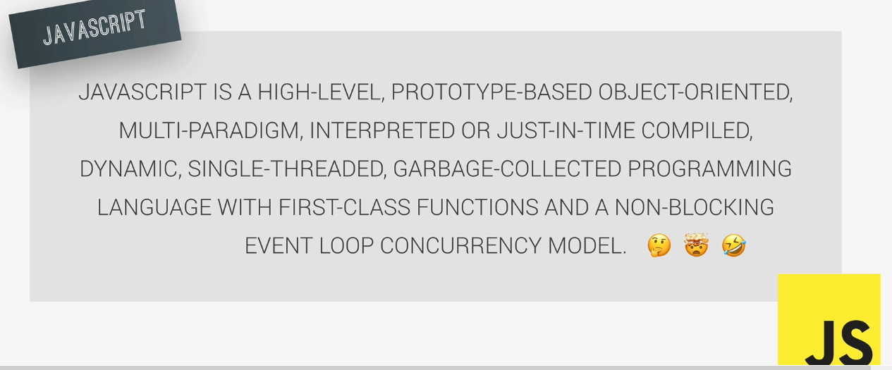

Slide 3
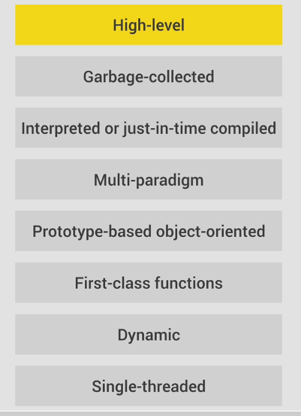

Slide 4
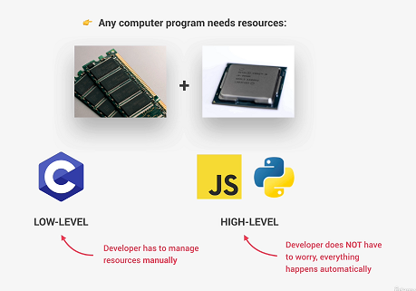
High Level

Slide 5
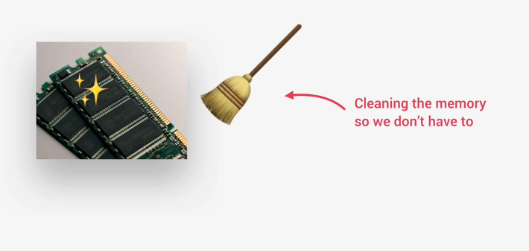
Garbage Collected

Slide 6
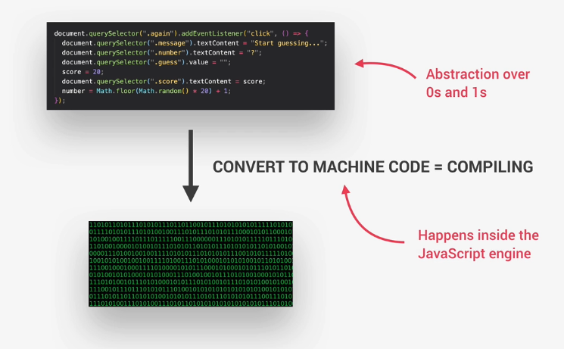
Interpreted – Just-in-time compiled

Slide 7
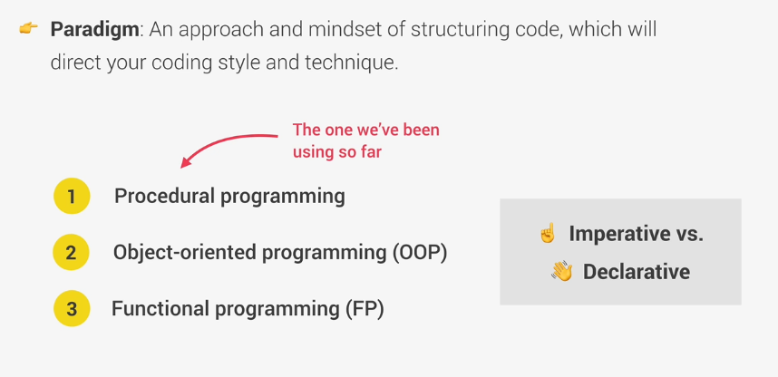
Multi-paradigm

Slide 8
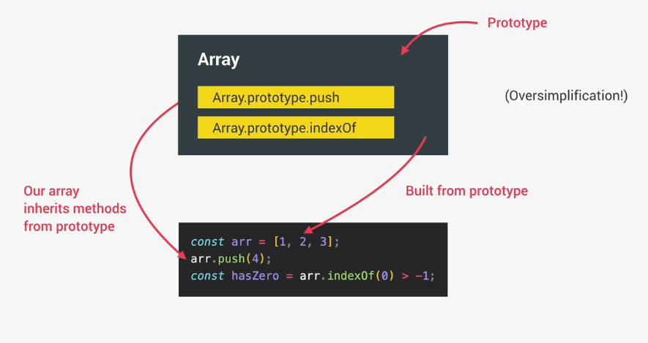
Prototype-based-object-oriented

Slide 9
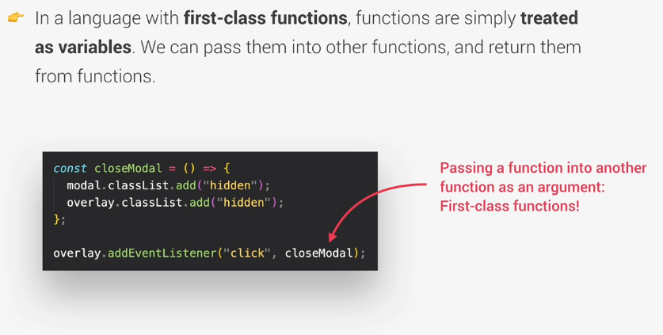
First-class-Function

Slide 10
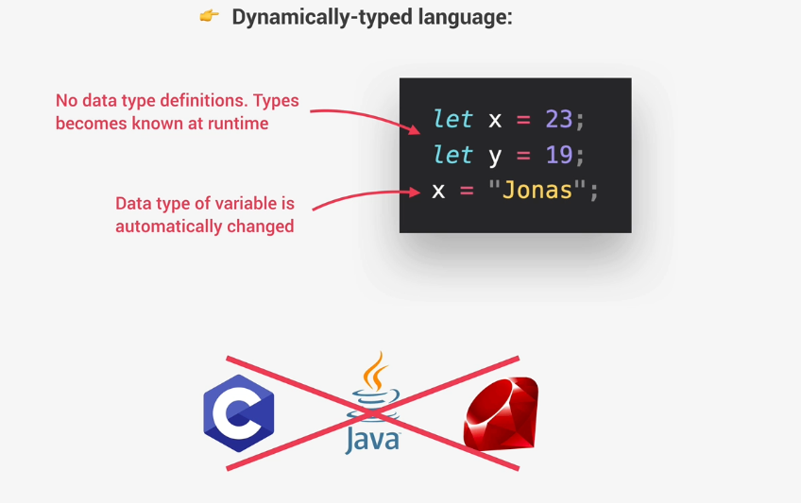
Dynamic

Slide 11
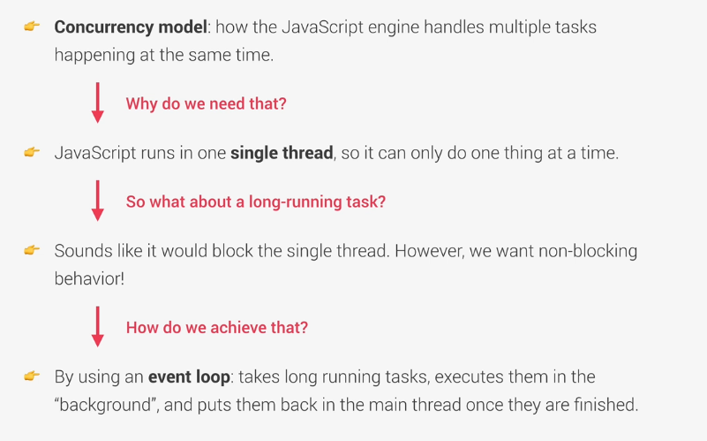
Single Threaded And Non-blocking Event loop

Slide 12
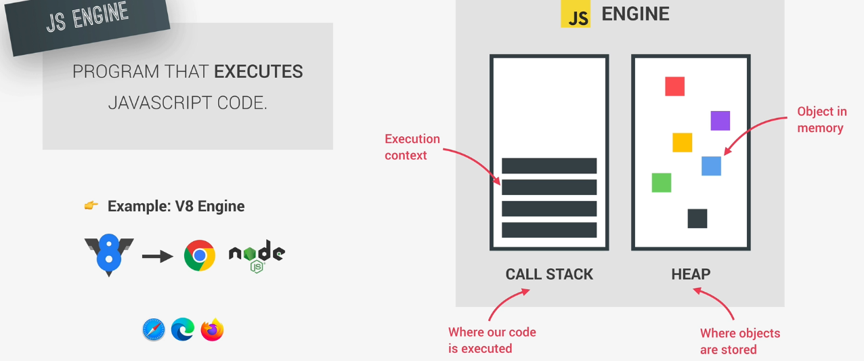
Javascript Engine

Slide 13
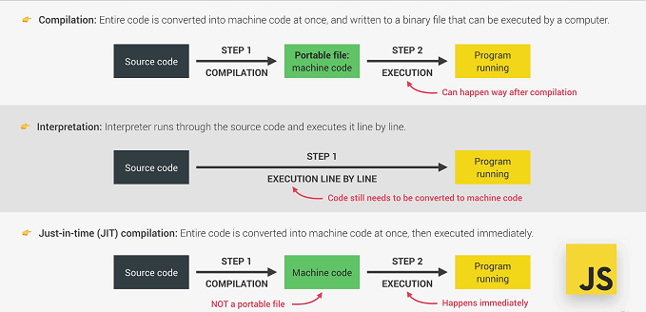
Compilation And Interpretation

Slide 14
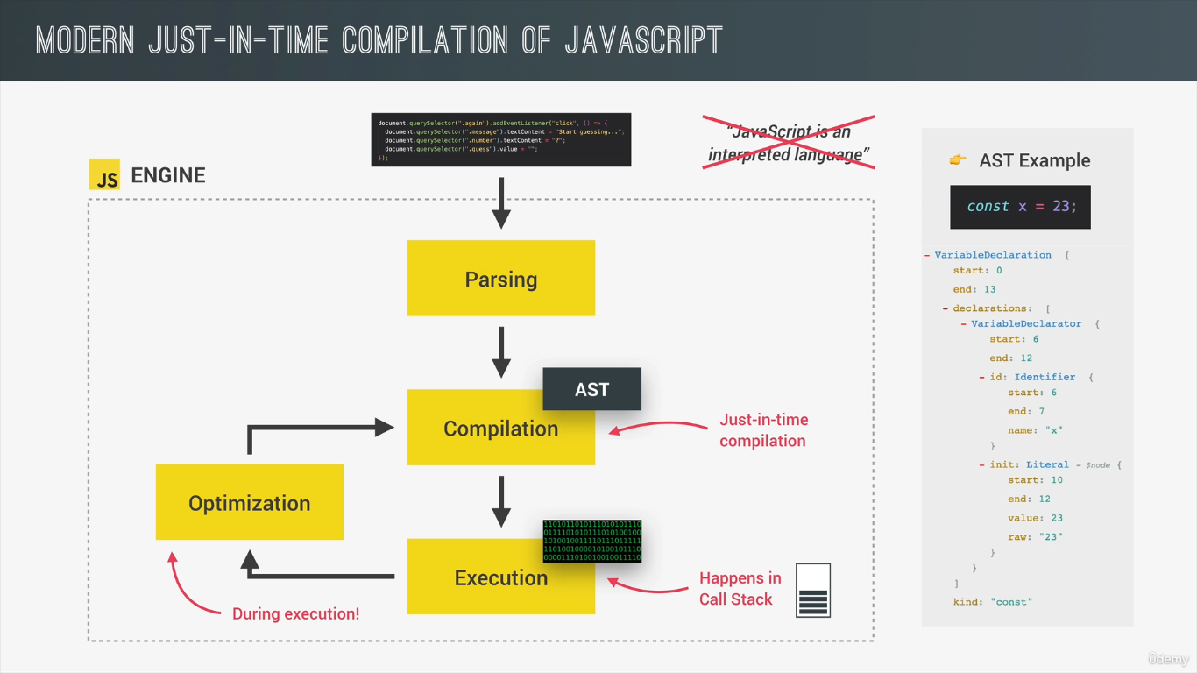
Compilation of javascript

Slide 15
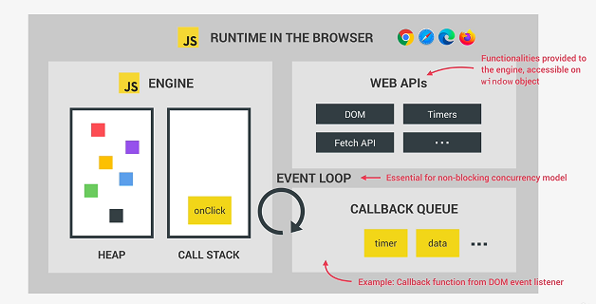
Javascript Runtime

Slide 16
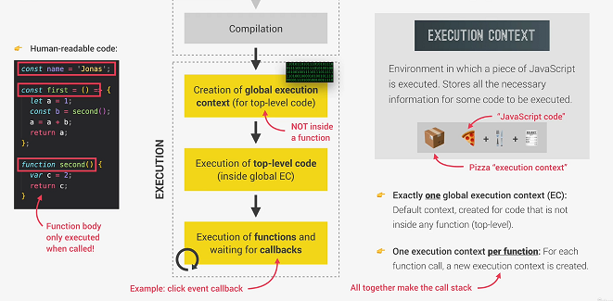
Execution Context

Slide 17
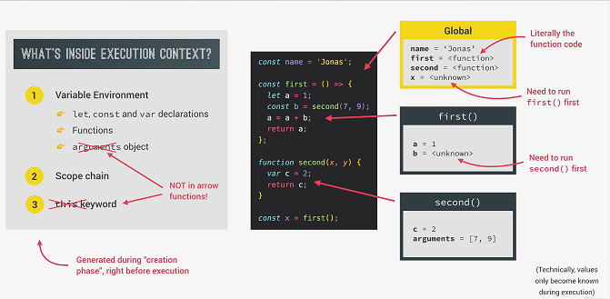
Execution Context

Slide 18
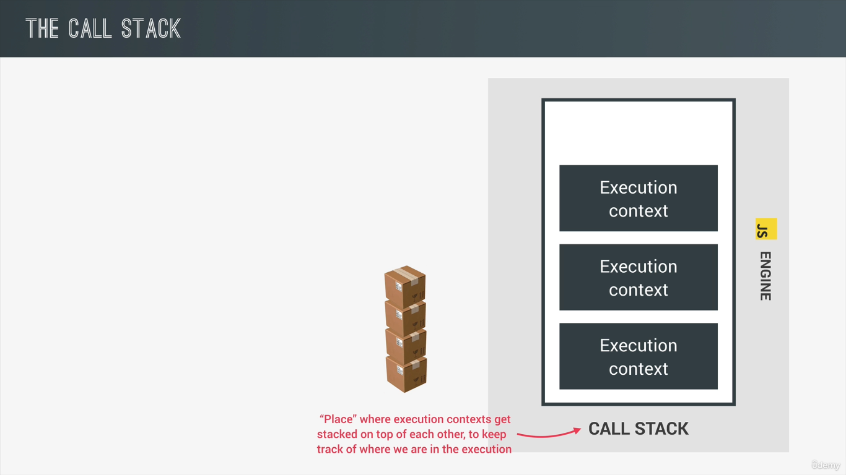
Execution Context – Call Stack

Slide 19
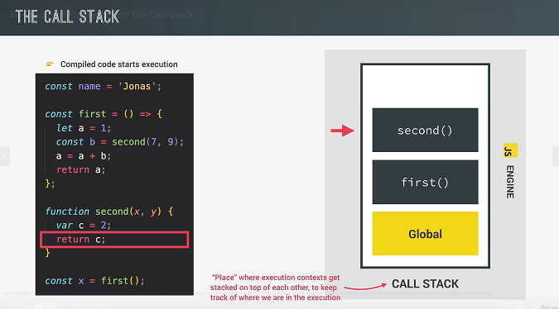
Execution Context : call stack - 1

Slide 20
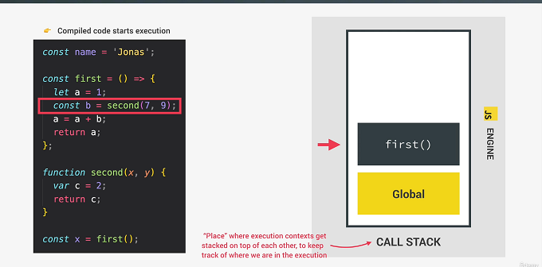
Execution Context : call stack - 2

Slide 21
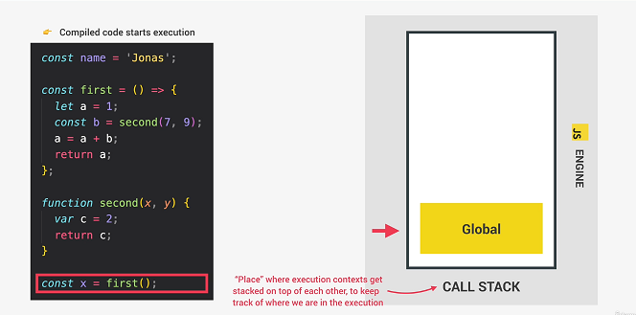
Execution Context : call stack - 3

Slide 22
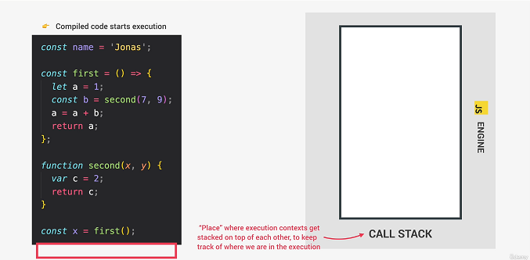
Execution Context : call stack - 4

Slide 23
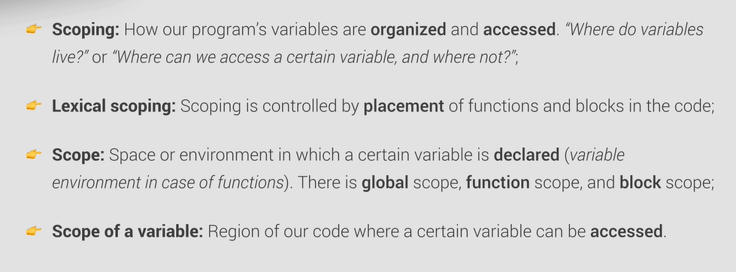
Scope Chain

Slide 24
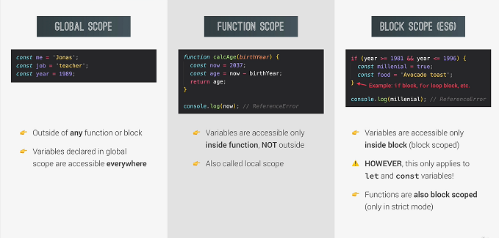
Types of Scope

Slide 25
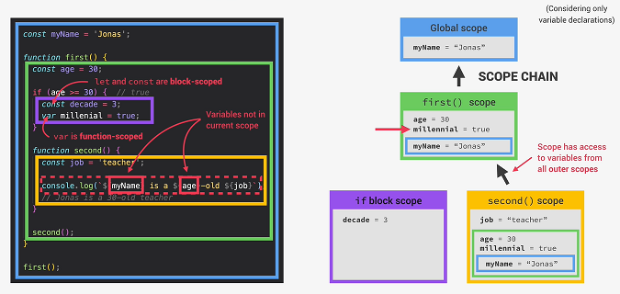
Scope Chain

Slide 26
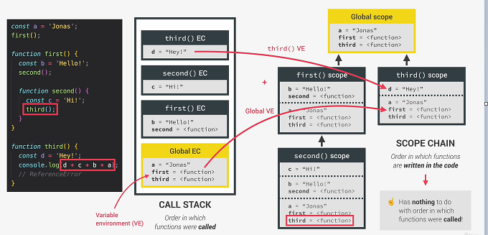
Scope Chain Vs Call Stack

Slide 27
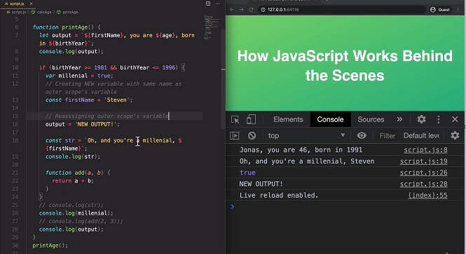
Scope Practice

Slide 28
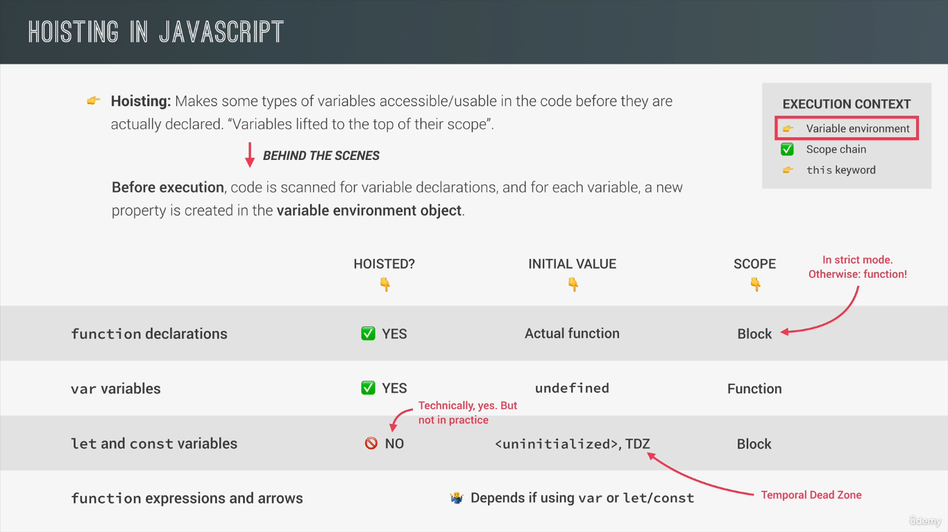
Hoisting

Slide 29
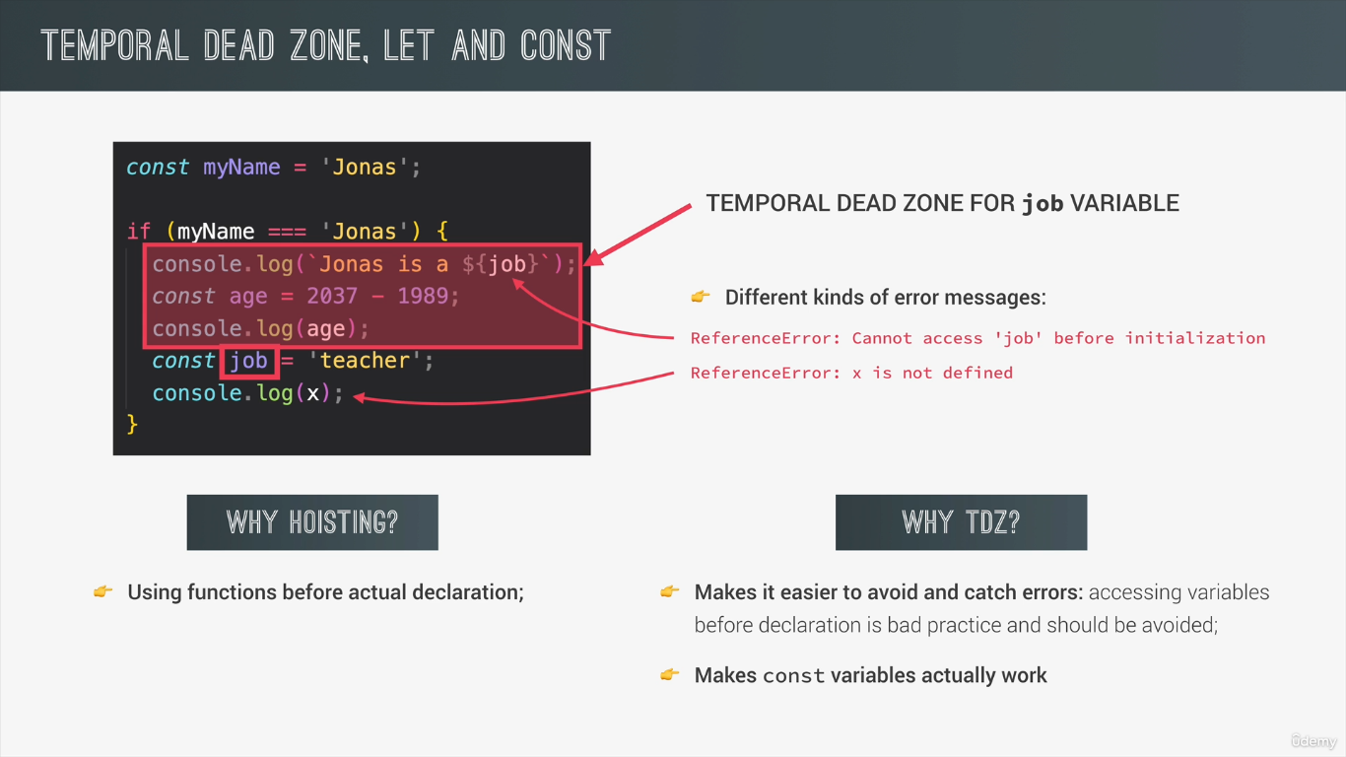
TDZ

Slide 30
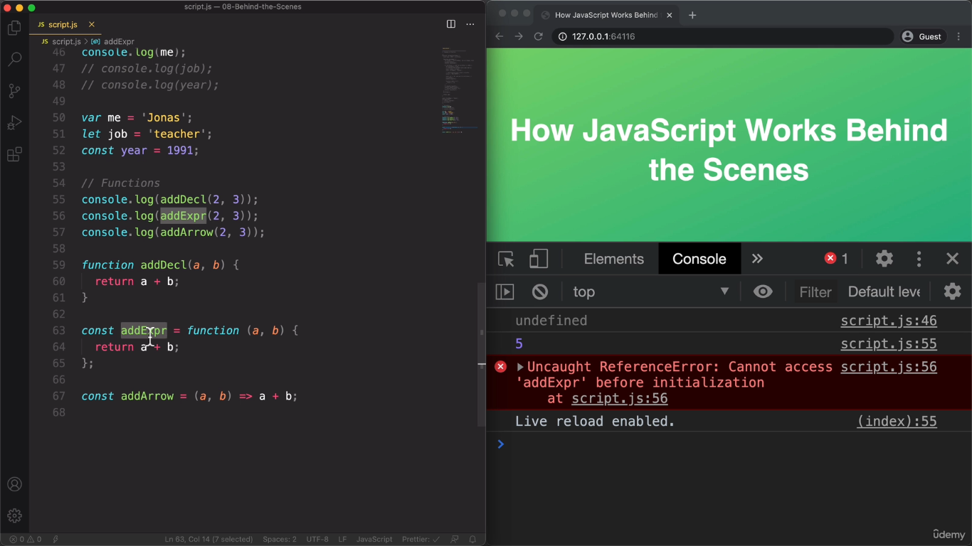
Hositing Practice

Slide 31
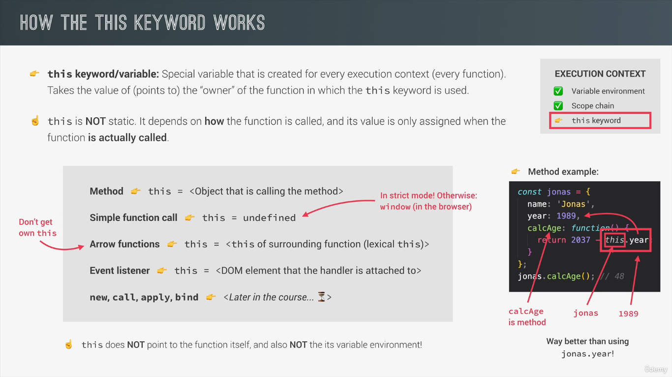
This keyword

Slide 32
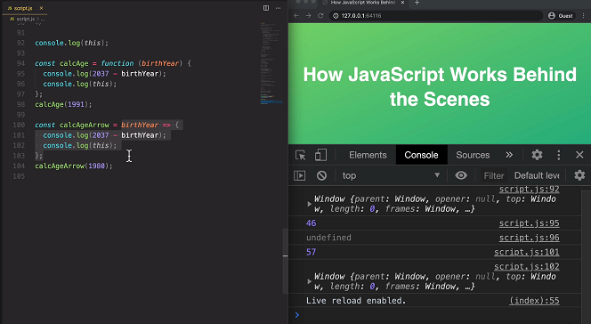
this keyword practice

